Slide 1
Milestone 4
Project --- Building A Multi-functional Discord Bot
Submitted By: -
Devesh Jangir
Prince Ahlawat
Abhas Singh

Slide 2
Progress made…..
During this time period, I have captured the design document under which I have made the:
Basic Structure Diagram
Use Case Diagram
Activity Diagram
Sequential Diagram

Slide 3
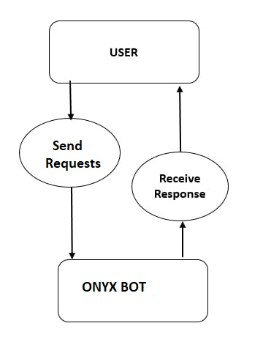
Attach all the snaps of the diagrams here
Basic Structure Diagram: -

Slide 4
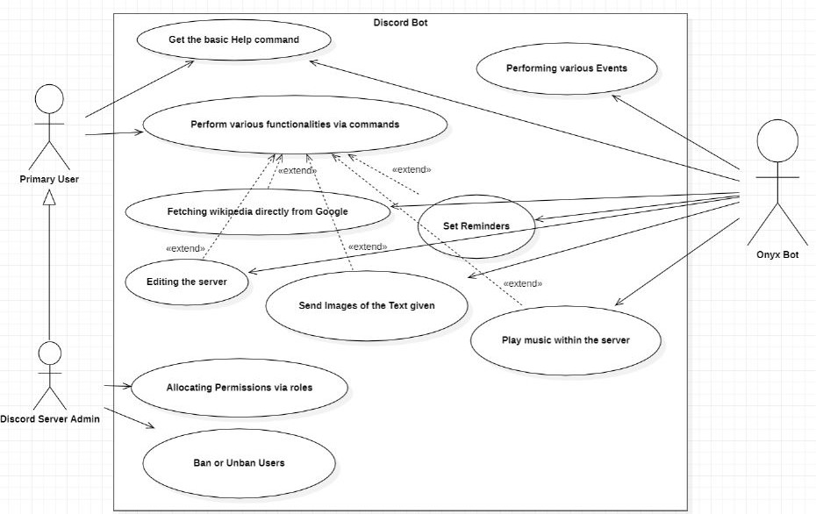
User Case Diagram: -

Slide 5
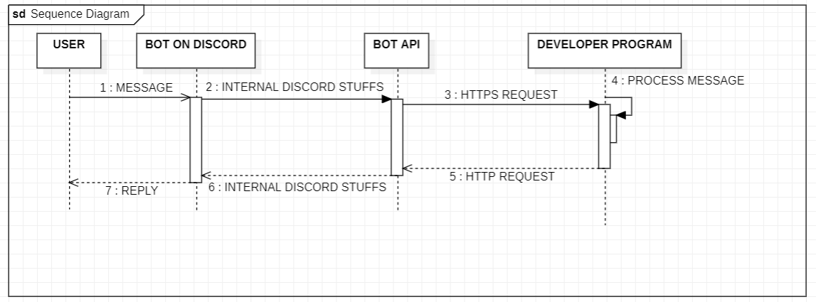
Sequence Diagram: -

Slide 6
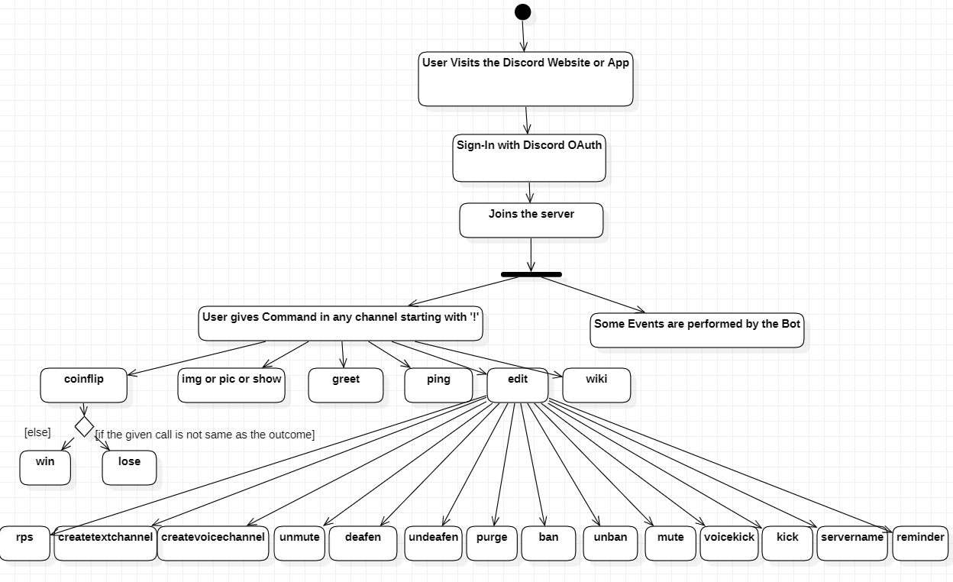
Activity Diagram

Slide 7
Partial Implementation
I have also done the partial implementation of my project. I have completed as well as implemented most of my functionalities.
The screenshots of which are attached in this & the upcoming slides.

Slide 8
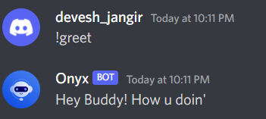
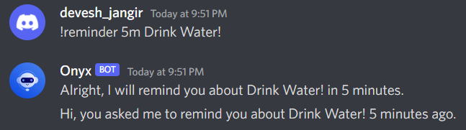
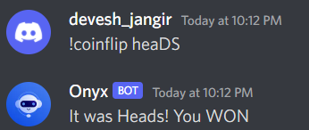
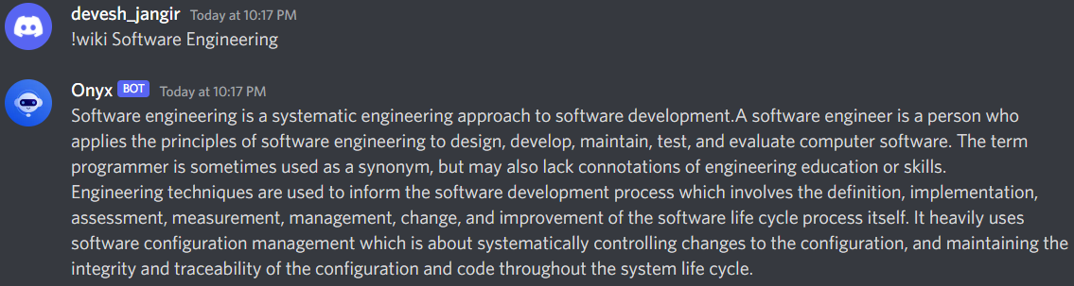
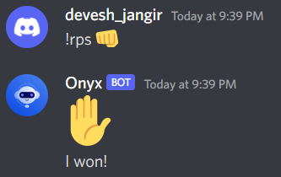
Attach the snaps of the functionalities here:

Slide 9
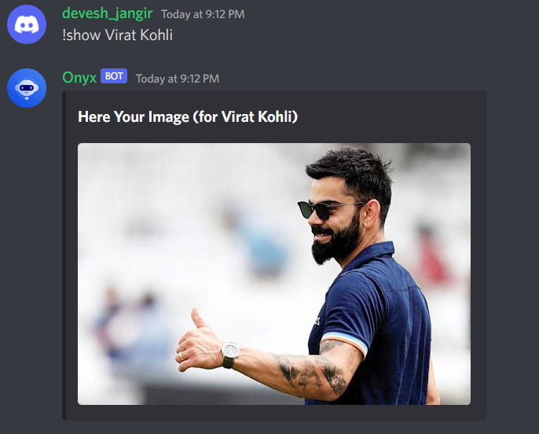

Slide 10
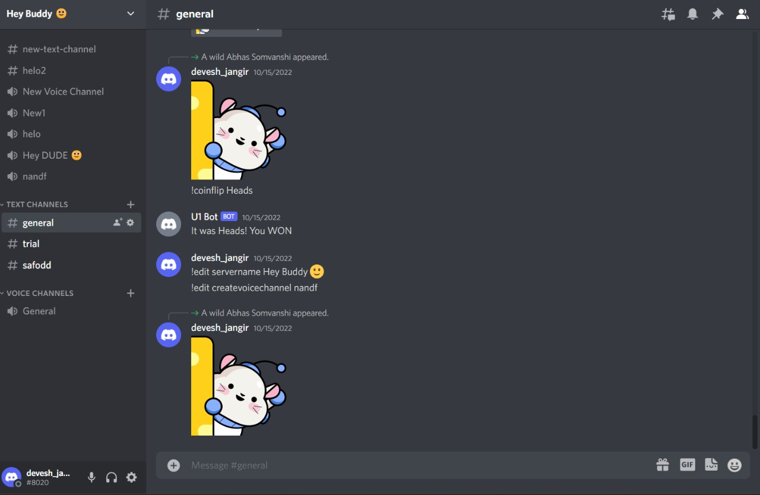
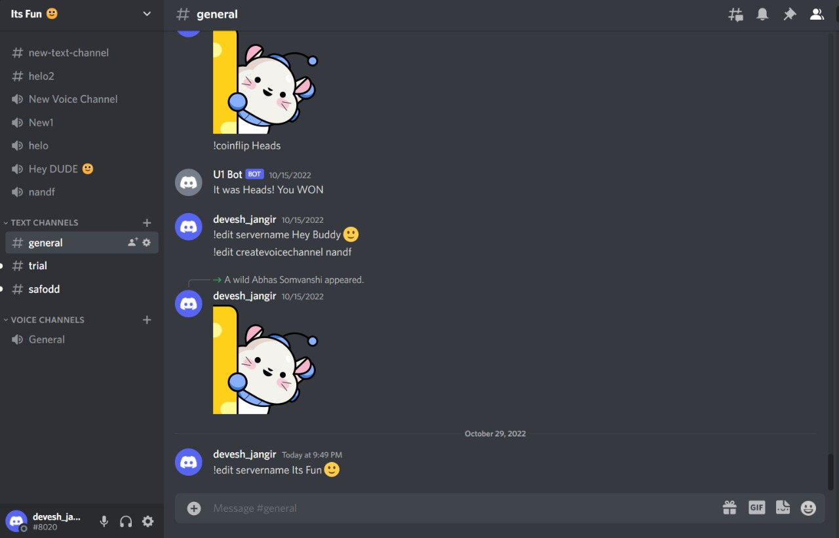
Changing Server Name:

